Slide 1
Visual Analytics– Color
Dr. Ab Mosca (they/them)
Slides based off slides courtesy of Jordan Crouser (https://jcrouser.github.io/)

Slide 2
Plan for Today
Color
Lab

Slide 3
Flashback: Mapping to visual dimensions
 | Perceived as similar | Perceived as different, forming families | Perceived as ordered | Perceived as proportional
SIZE | ?
VALUE | ?
COLOR |  |  | ?
SHAPE
ORIENTATION

Slide 4
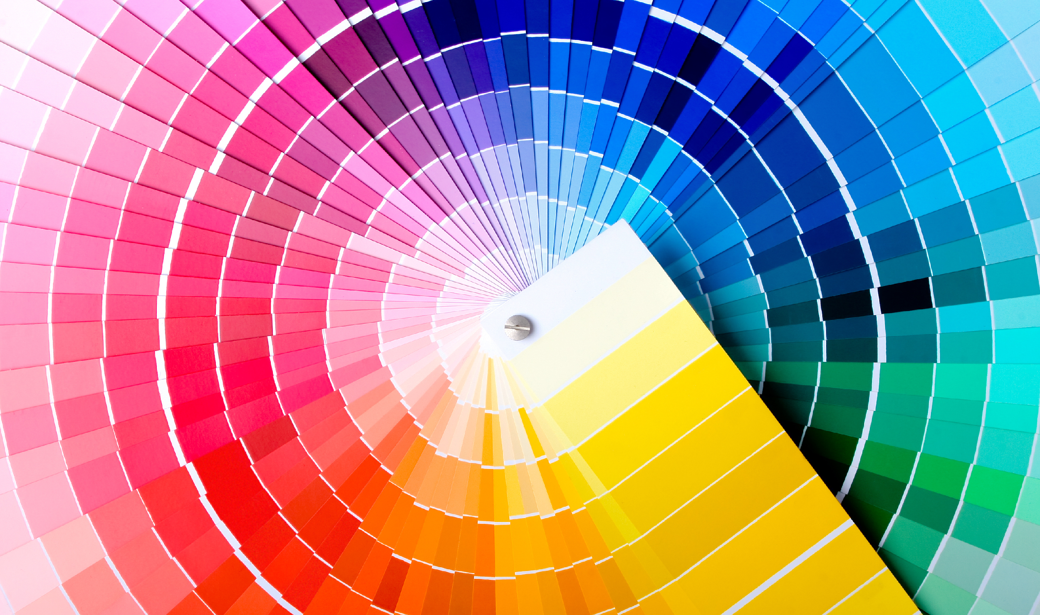
Color 101

Slide 5
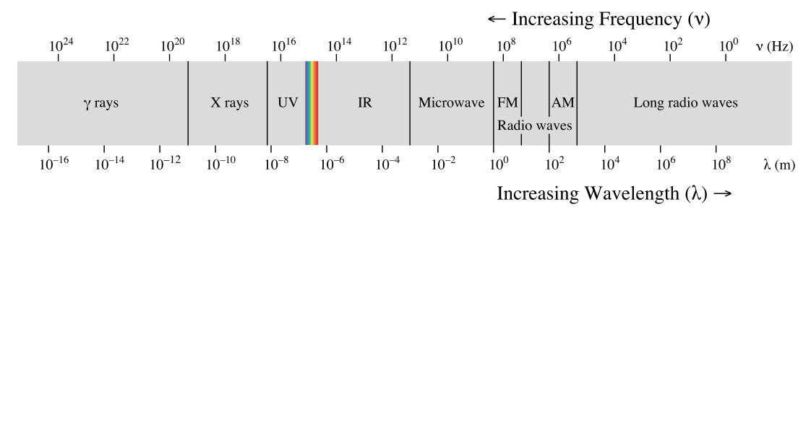
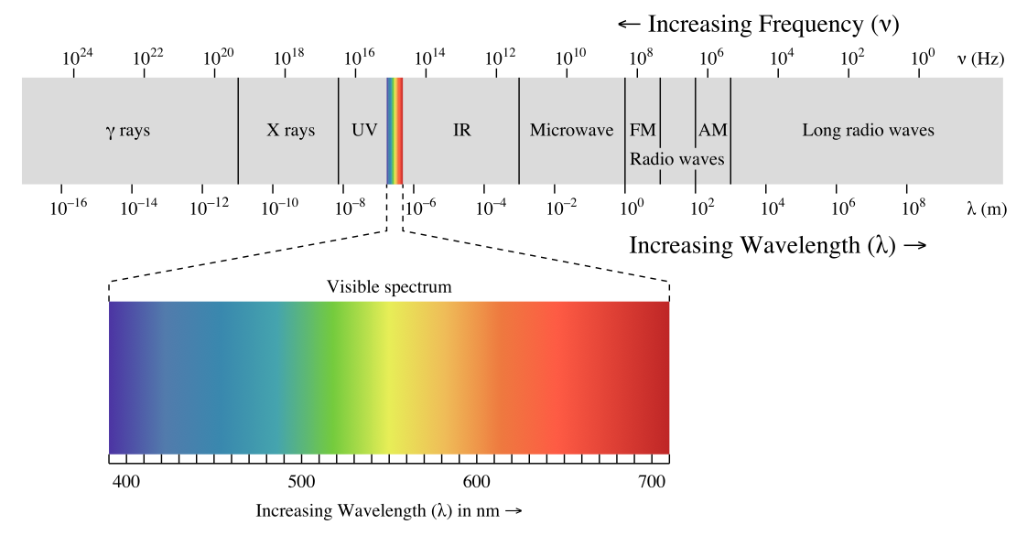

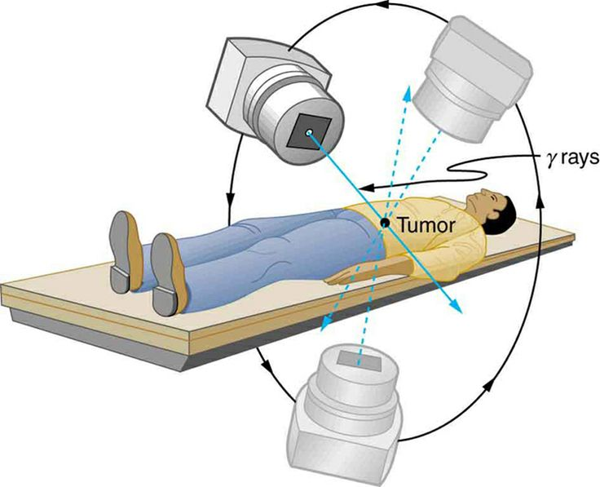
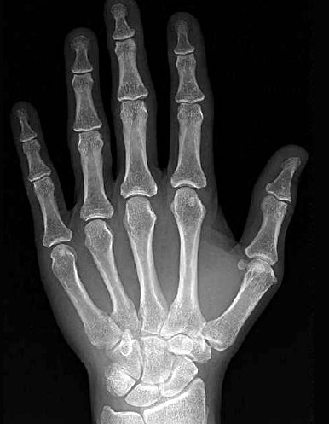

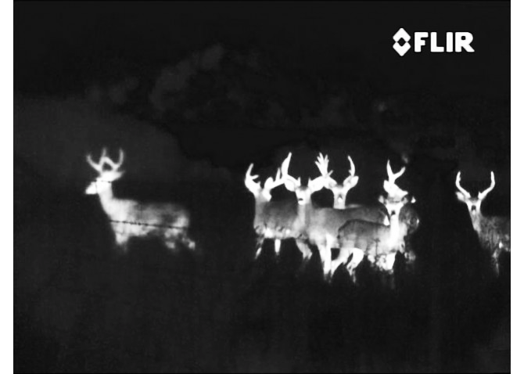
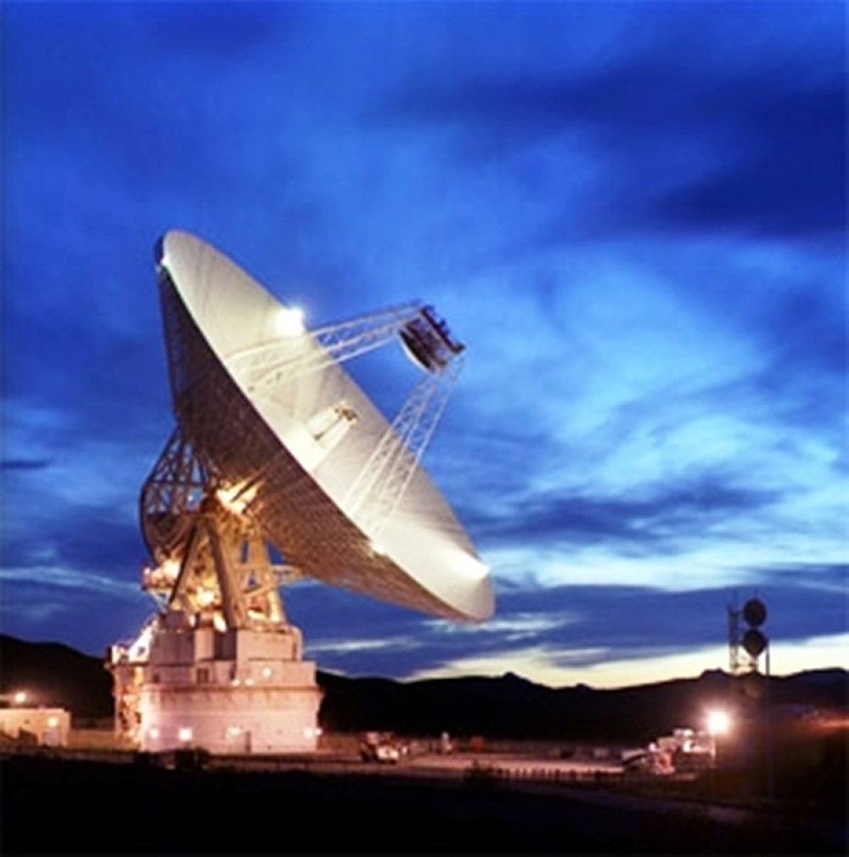
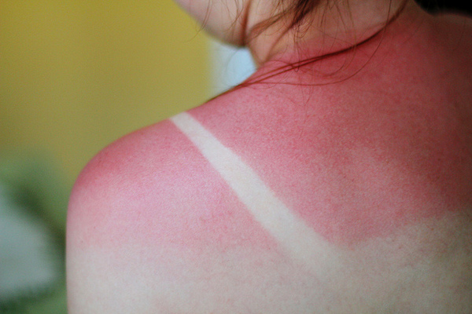
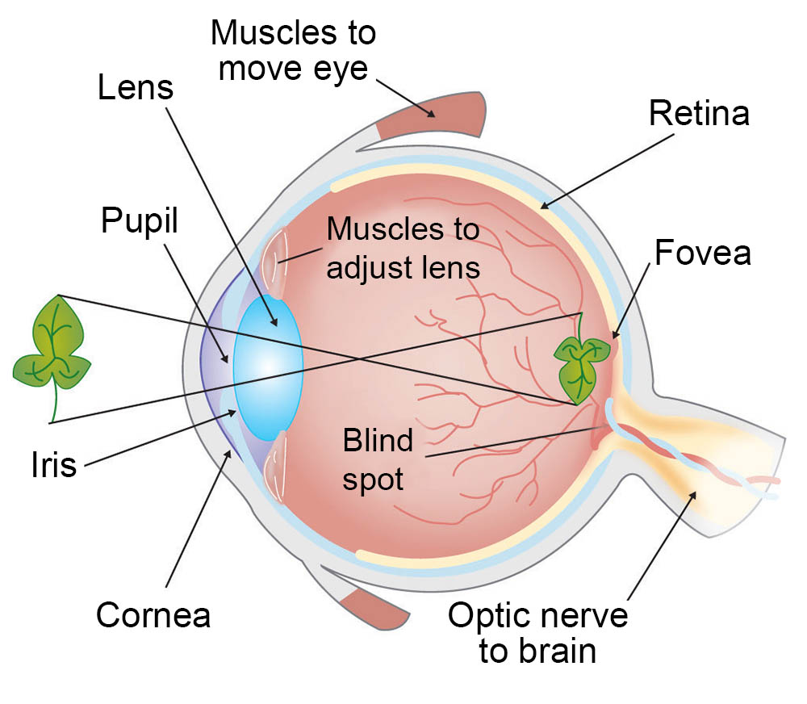
Kinds of light
Eye diagram courtesy ASU

Slide 6
How we see color

Slide 7
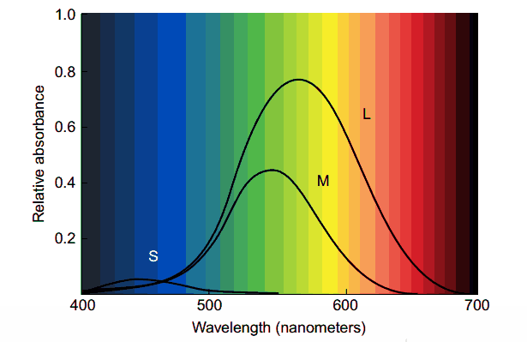
3 kinds of color sensors
How we see color

Slide 8
3 kinds of color sensors
How we see color
What do you notice here?

Slide 9
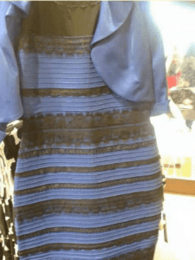
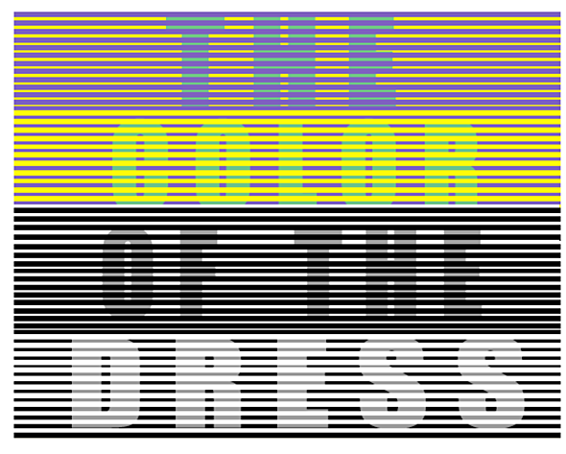
Color phenomena

Slide 10
Caveat 1: color is perceived in context
Color phenomena
Which small square is darker green?

Slide 11


Caveat 2: difference is relative
Color phenomena

Slide 12
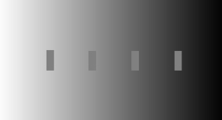
Caveat 2a: so are brightness and contrast
Color phenomena

Slide 13
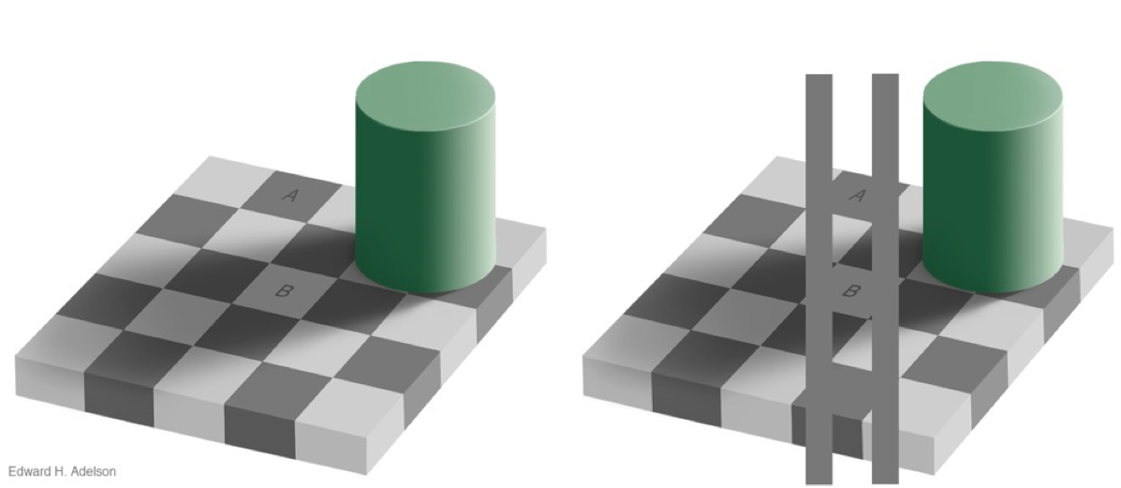
Caveat 3: mental models > perception
Color phenomena

Slide 14
Color palettes
Using a poor color scheme can also cause issues with your visualization

Slide 15
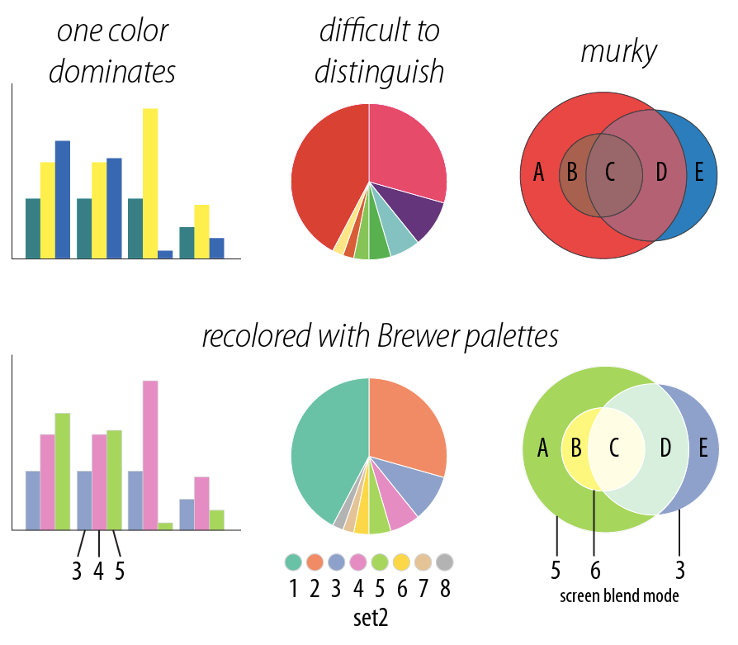
One color dominates
Difficult to distinguish
Color Problems
Murky

Slide 16
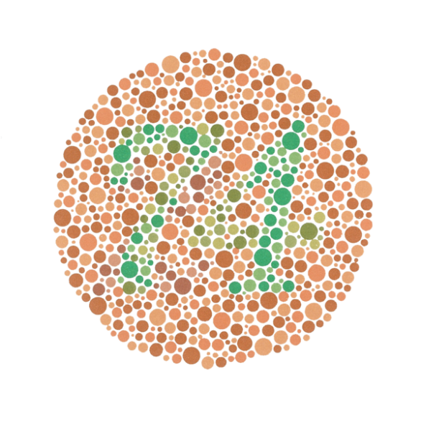
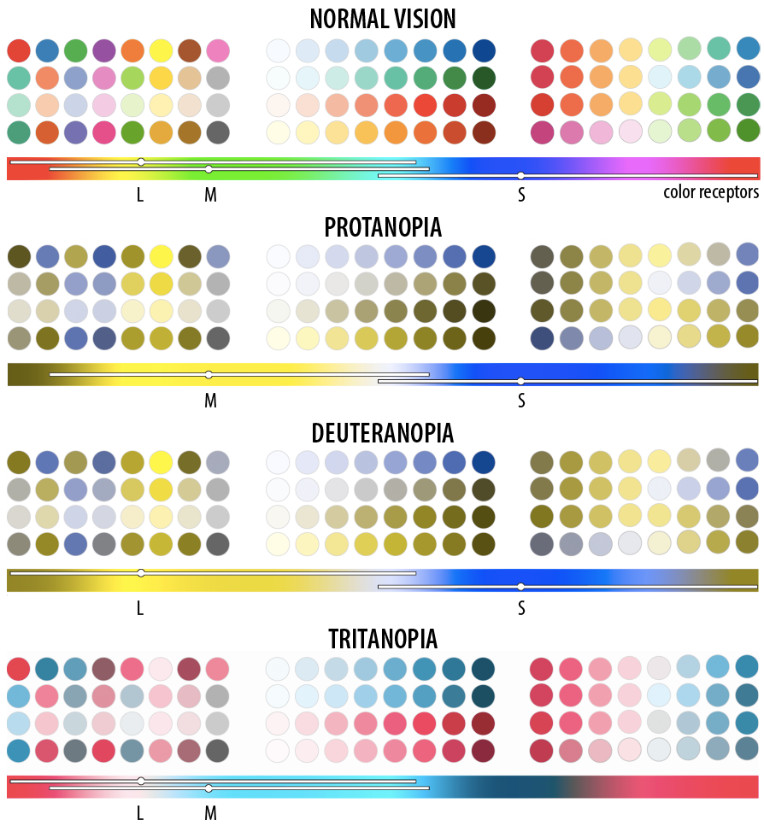
Fun fact: “colorblindness”
1 out of every 8 people has just 2 types of color receptors (rather than 3)

Slide 17
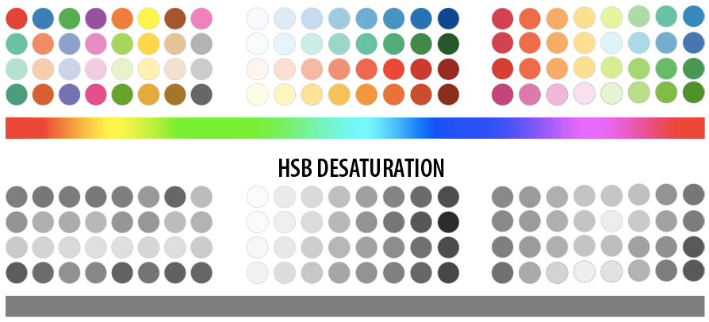
What happens when you print?
Need color scheme that converts well to grey scale

Slide 18
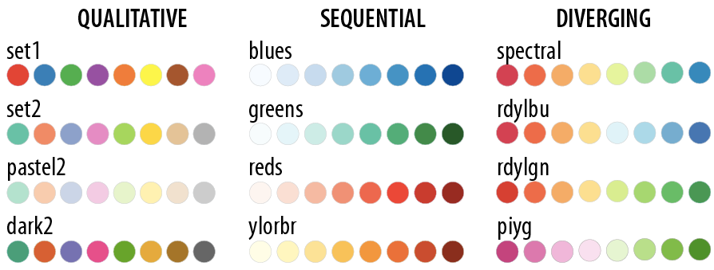
colorbrewer.org provides a whole bunch of palettes that can help us avoid these issues
This makes life a lot easier for us!
Colorbrewer palettes

Slide 19
colorbrewer.org provides a whole bunch of palettes that can help us avoid these issues
This makes life a lot easier for us!
Colorbrewer palettes
When should we use each type of color palette?

Slide 20
Find a partner
Open a dataset of your choosing
Build two visualizations on this dataset
One that tells the “real” story in the data (as you understand it), using color to represent at least one variable
One that uses color in an intentionally misleading way
Don’t share your misleading visualization with another group while you’re working! We’ll swap later and see if anyone outside your group can identify the misleading encoding
Mini-lab: color tricks

Slide 21
What did you try?
What did you learn about the data?
Can you imagine a scenario that might incline someone to choose your “bad” visualization instead of a better one?
Discussion

